Slide 1
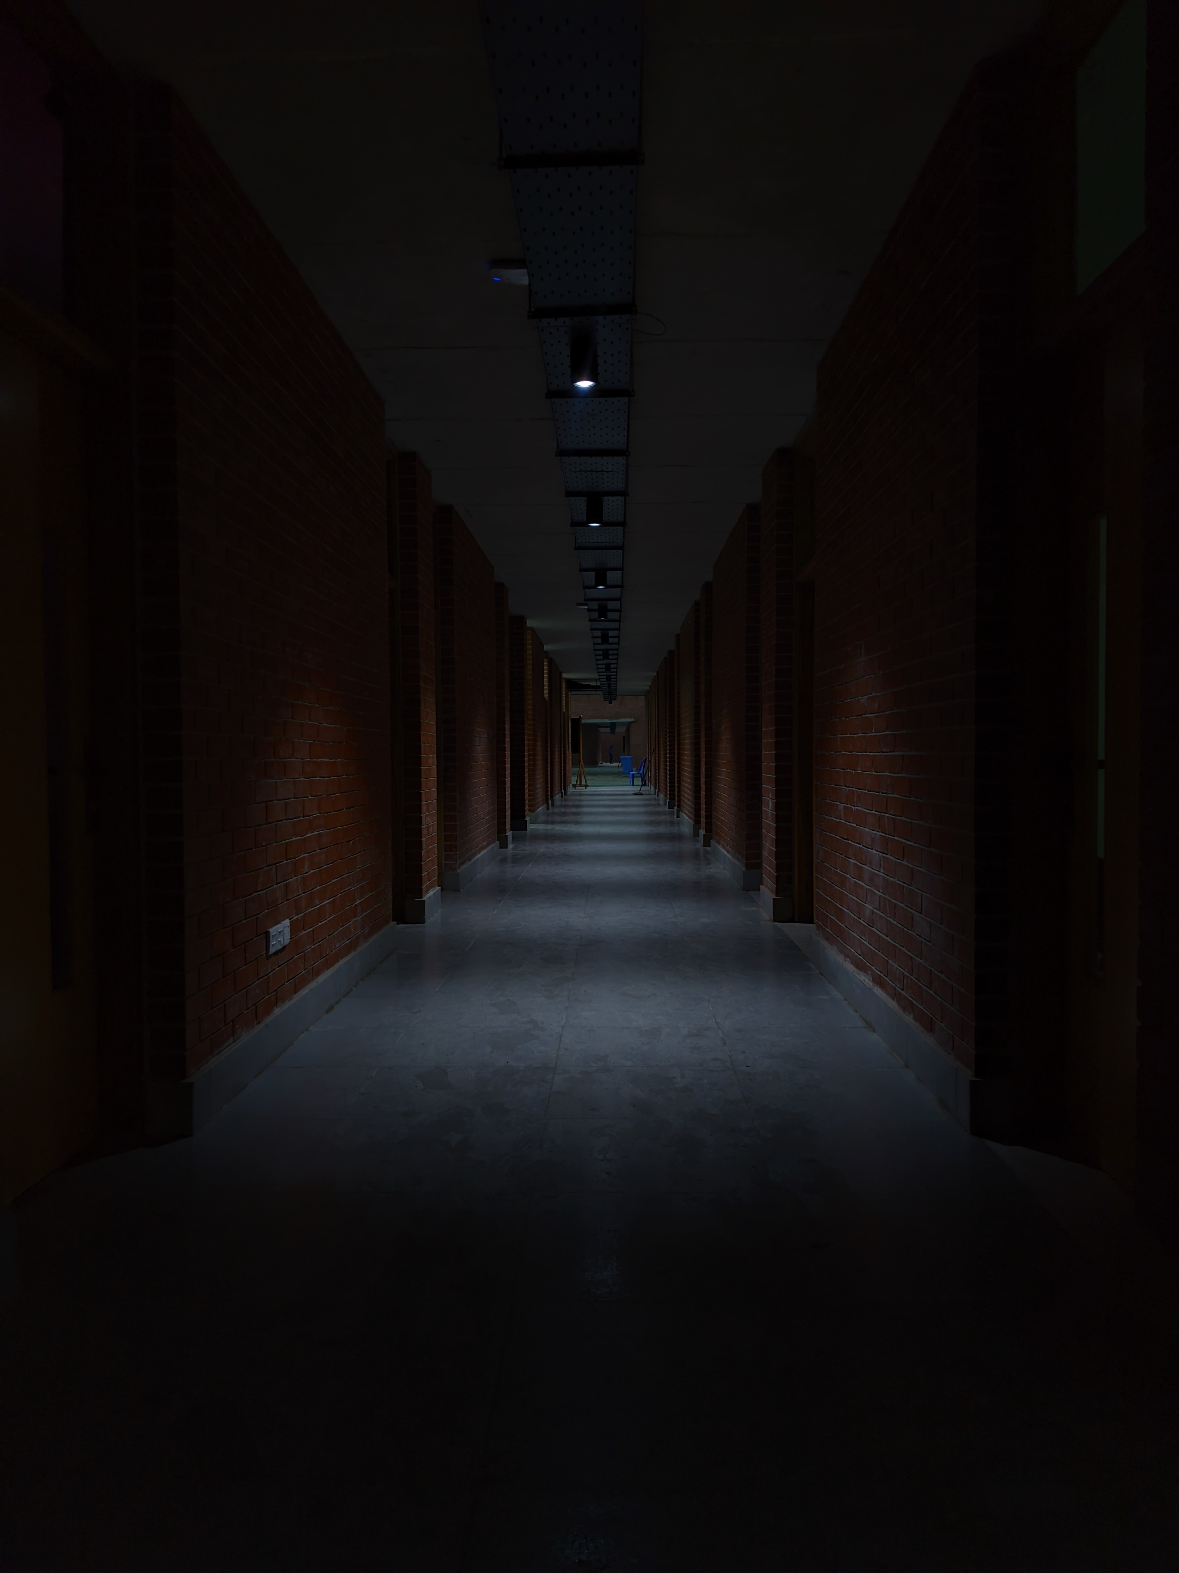


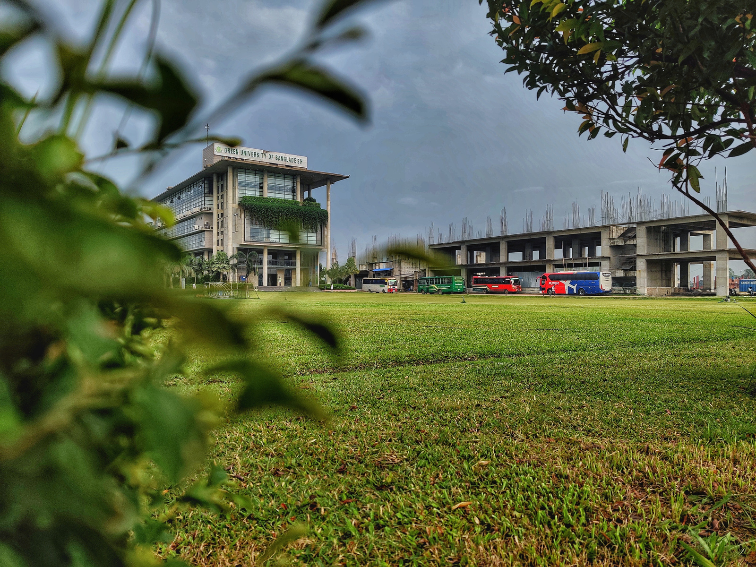


Green University of Bangladesh
Department Of Computer Science and Engineering(CSE)
Course Title: Information System and Design
Course Code: CSE 403 Section: 221 D13
Presented to
Mahjabin Rahman Oishe
Lecturer, Dept. of CSE
Green University Of Bangladesh
1

Slide 2

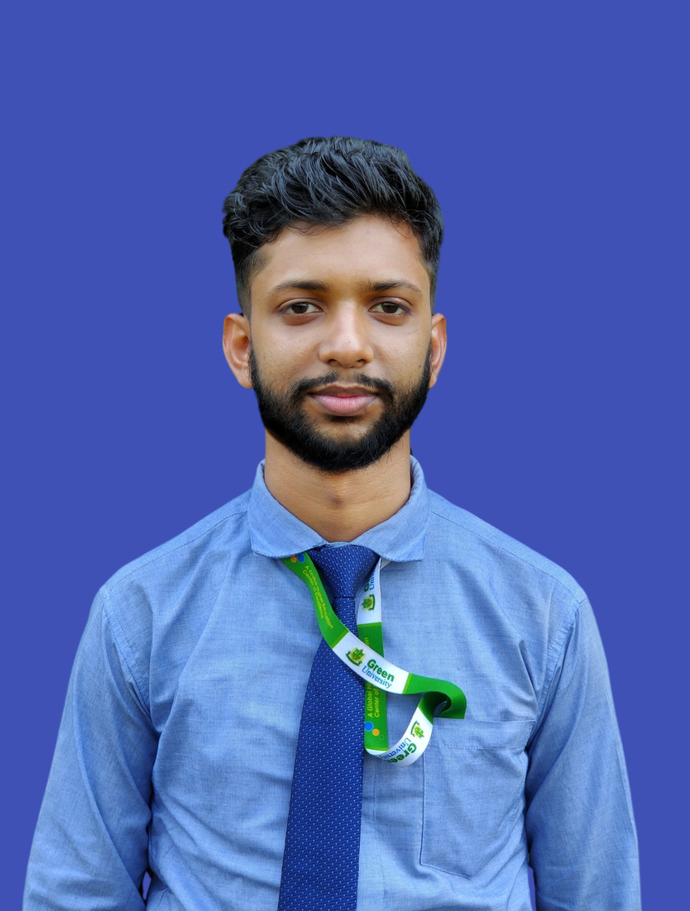
Md. Mahim Hossain
221902082
2

Slide 3





Welcome To Our Presentation
PROGRAMMING HERO
3

Slide 4



Agenda
Brief Of Company
Vision & Mission
Service Provide
Growth
Phitron
Limitation & Future Scope
Conclusion
4

Slide 5

PROGRAMMING HERO
BRIEF OF COMPANY
We focus on teaching programming and then helping our successful students to land a job/internship.
Address:
Level-4, 34, Awal Centre, Banani, Dhaka
Email: jhankar@programming-hero.com
Phone: +880 1322 810 863
Web: www.programming-hero.com
CEO
Founder,
4

Slide 6

PROGRAMMING HERO
VISION & MISSION
Vision
To be a global leader in programming education, offering interactive and engaging learning experiences.
Mission
To make programming education fun and accessible for everyone, empowering individuals with the skills to excel in the tech industry.
5

Slide 7




PROGRAMMING HERO
SERVICE PROVIDE
Web
Development
Course
Neptune
Job
Placements
Programming Hero Mobile Application
6

Slide 8
Md. Mahim Hossain
221902082
2

Slide 9


PROGRAMMING HERO
GROWTH
7

Slide 10
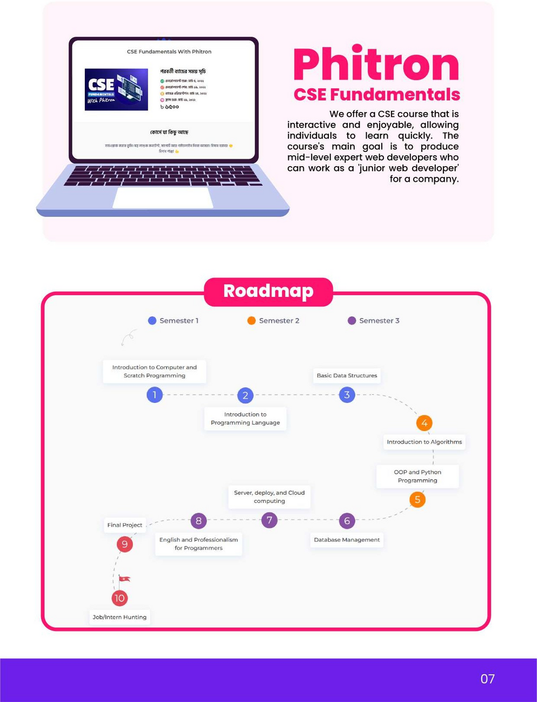
PROGRAMMING HERO
PHITRON
Semester 01
Semester 02
Semester 03
8

Slide 11

PROGRAMMING HERO
THANK YOU
Thanks everyone for being here – your presence means a lot!
9

